Slide 1

15CSE313 Software Engineering Project Sprint 2 Review
Abhilash V CB.EN.U4CSE16101
Team Name:Evention
Batch:B
Akshaya S CB.EN.U4CSE16103
BIndu Trilekha M CB.EN.U4CSE16128
Niranjan Kumar S CB.EN.U4CSE16134
Uma Subbiah CB.EN.U4CSE16159

Slide 2
Problem Statement
To design an event management portal for making the entire process of conducting an event easy. The complex nature of conducting an event and overseeing the entire flow has facilitated the need for a management system to guide the customer through the whole process smoothly. The customer portal that we provide integrates all of the customer's events at one site, where he/she can view/edit the details of the events. Requesting, modifying and cancelling events has also been made easy through our website. Backend database integration ensures that all the information is available on demand, yet secure from unauthorised access. Employees are also be able to easily view and manage all the necessary details.

Slide 3
Technology used
This is a web-app
Stack Used:
MS-SQL
ExpressJS
NodeJS
Node Modules used:
MSSQL
AWS
ExpressJS
URL
FS (File System)
JSON
Formidable
We also used Python, JavaScript, BootStrap, CSS, HTML, GitHub, Visual Studio Code.

Slide 4
Agile Statistics
Sprint 1 - # of stories
Created the user interface for customers, employees and the public.
Akshaya - 4
Abhilash - 3
Trilekha - 4
Uma Subbiah - 4
Niranjan - 4

Slide 5
Sprint 2 - # of stories
Linked the front end to the database, handled errors, testing done
Abhilash - 5
Niranjan - 4
Uma Subbiah - 4
Trilekha - 4
Akshaya - 3

Slide 6
Tools used and Statistics

Slide 7
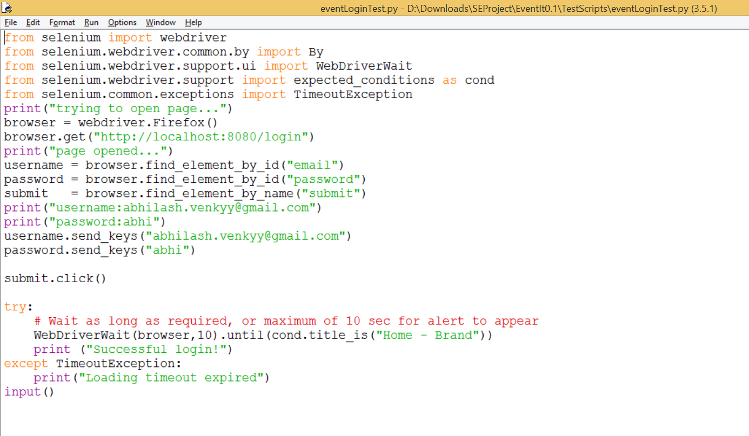
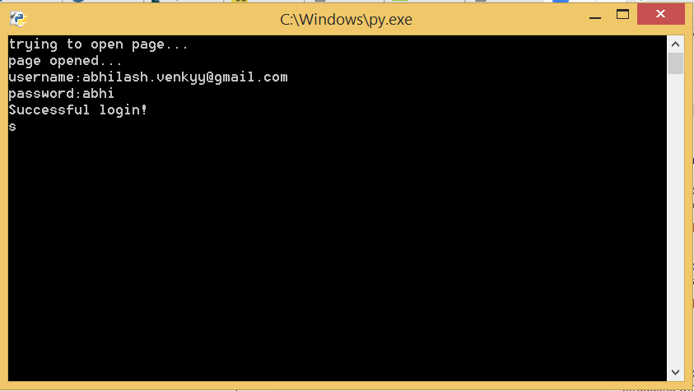
Selenium

Slide 8
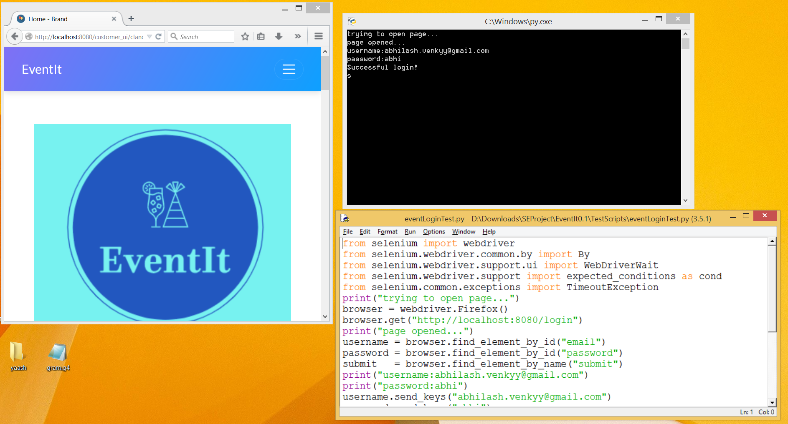

Slide 9
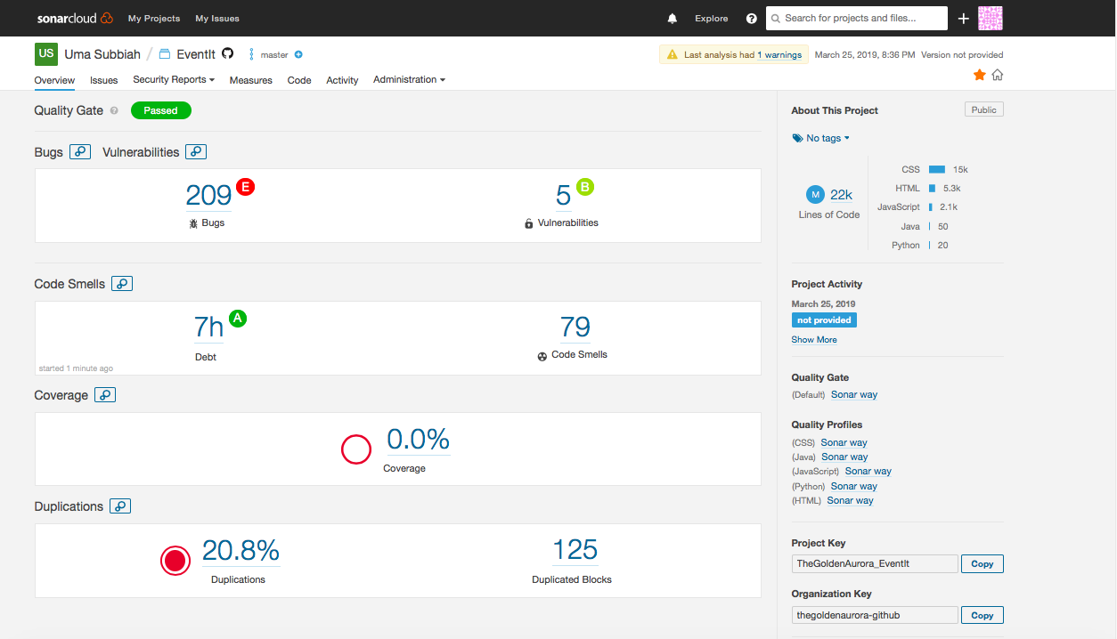
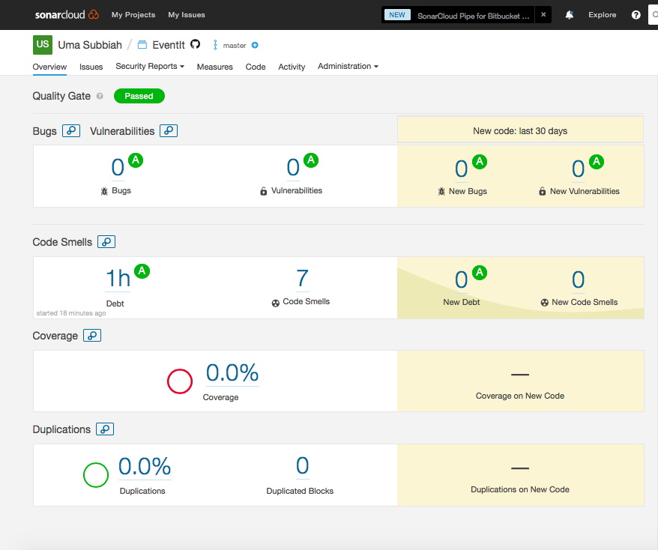
SonarQube
Ran SonarQube (a static code analyser) on the entire project. It detected an error. After rectifying the error, we re-ran SonarQube and it showed that the bug had been resolved.

Slide 10
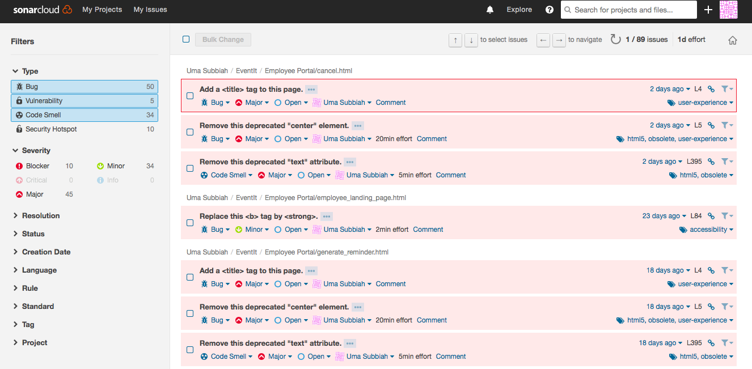

Slide 11
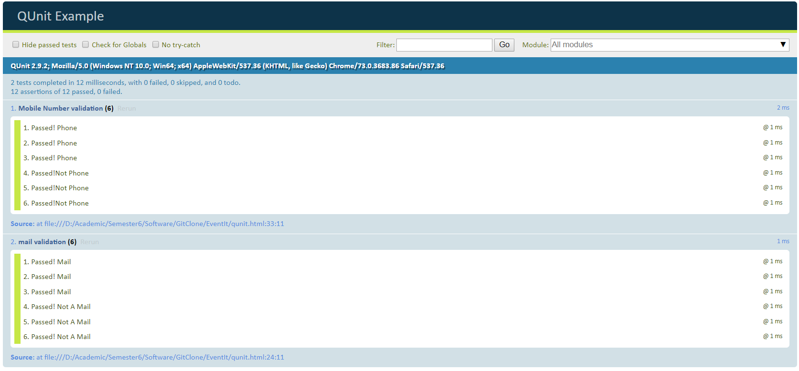
QUnit

Slide 12
